Slide 1


Heart Disease Prediction by Machine Learning
Under the guidance of
Dr. Surendra Kumar Shukla
Parth Sarthi
Uni Roll: 2017520
Section: CST SPL1 , 51
Course: B. Tech CST (ML&AI)

Slide 2
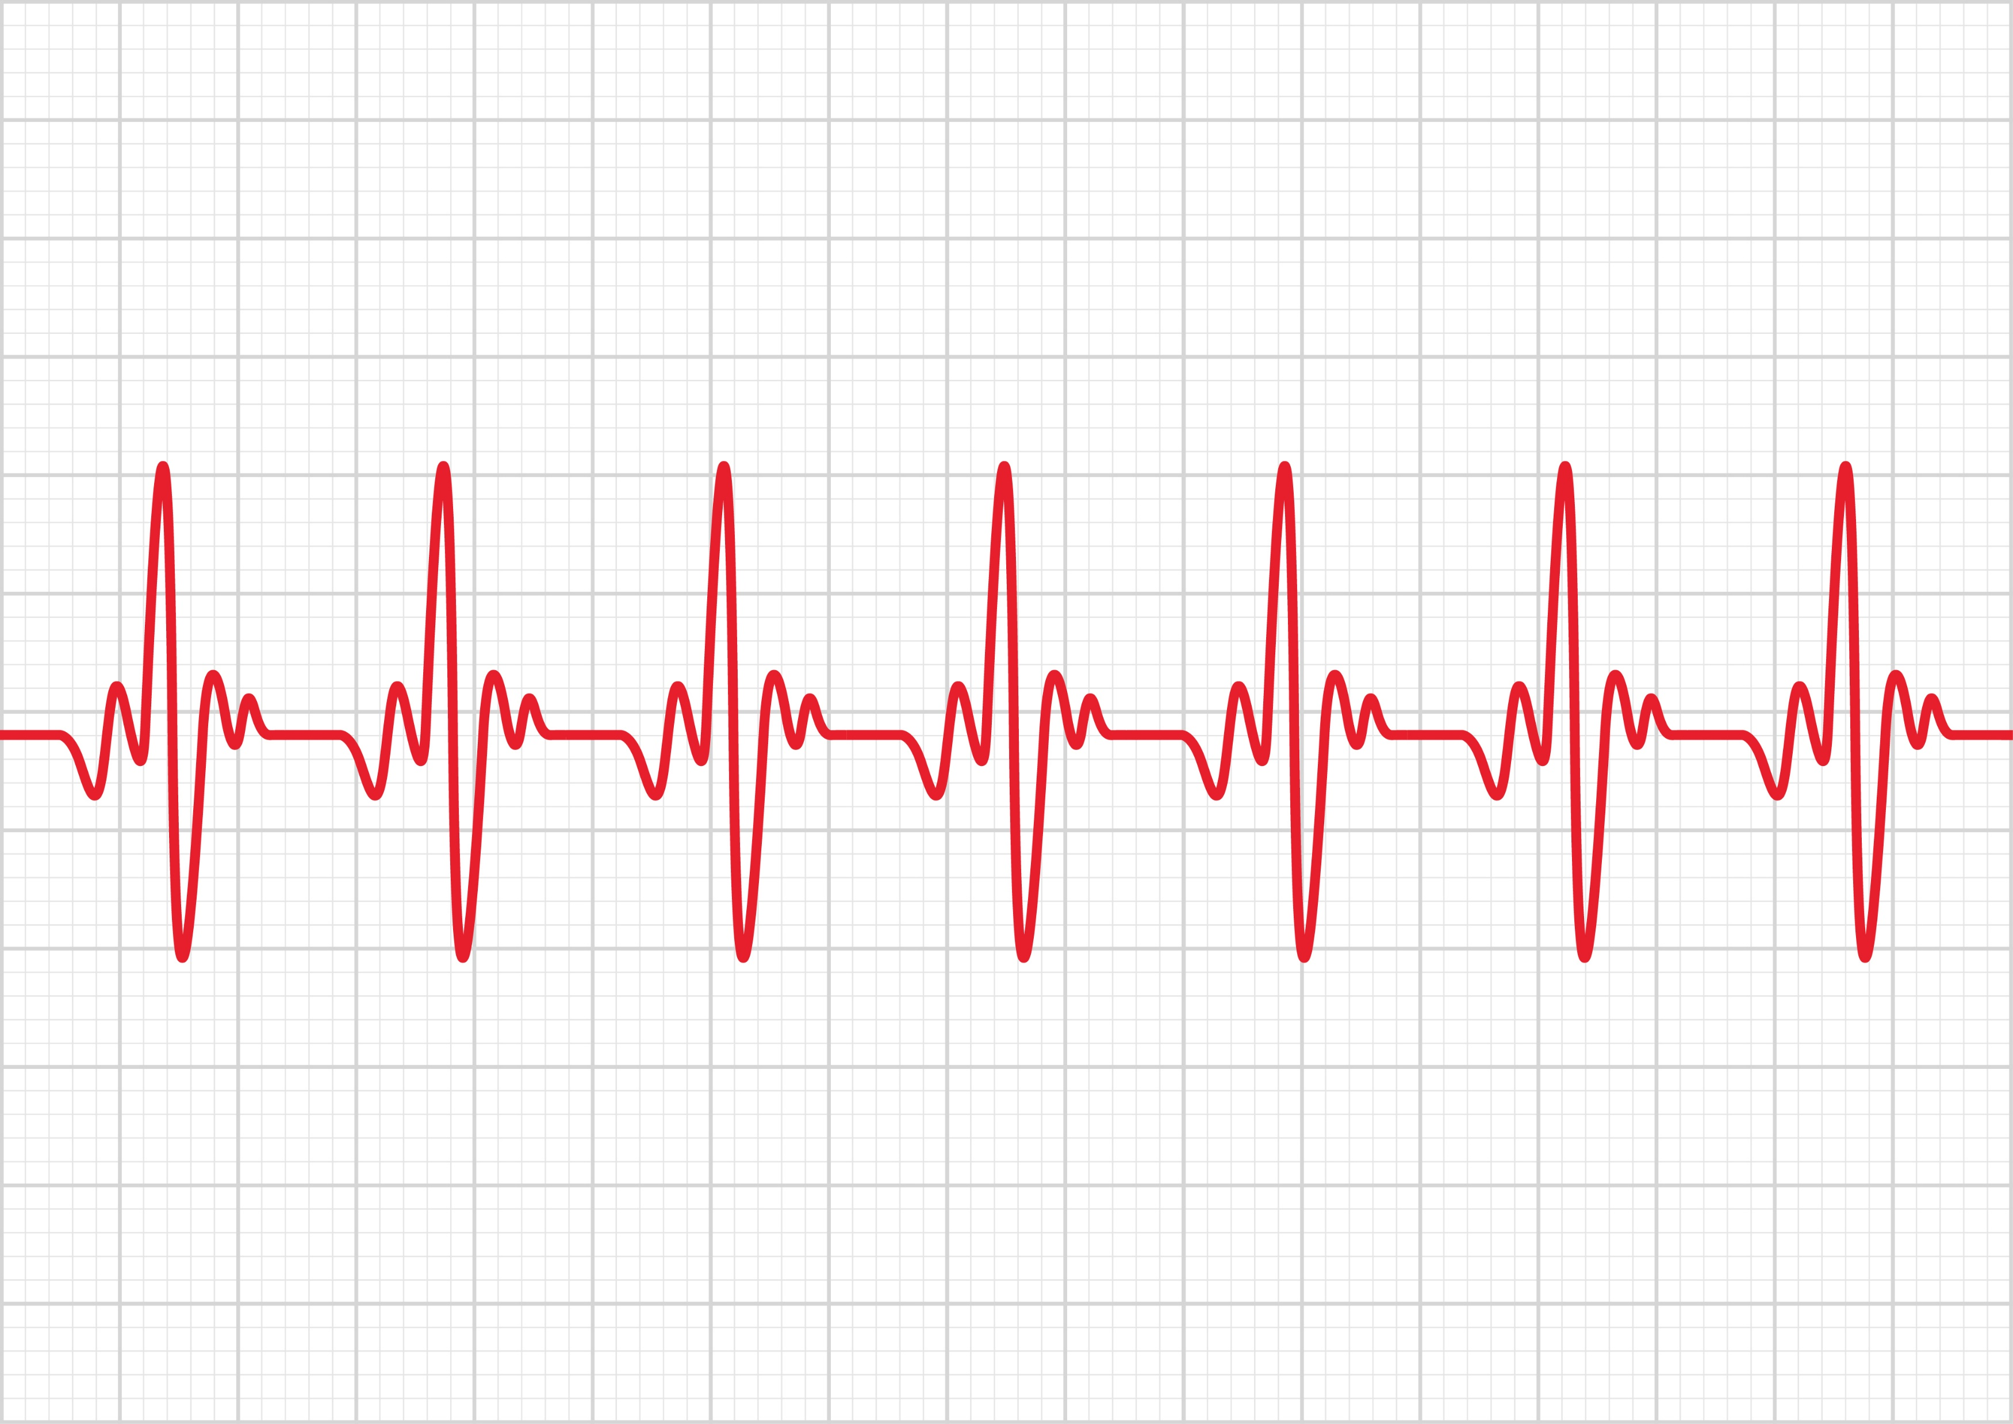
PROBLEM STATEMENT:
To create a Machine Learning model to predict the possibility of a potential heart disease.
INTRODUCTION:
Heart disease is something that affects people of all age groups and different walks of life.
It can be genetic as well as a result of bad lifestyle habits.
If identified and treated on time it can help save a person’s life.
In the past few years machine learning algorithms have emerged as powerful tools for analysing large datasets and extracting meaningful patterns that can help derive useful results
Machine Learning can help doctors identify and predict the onset of a cardiovascular complication in a patient with latent symptoms.

Slide 3
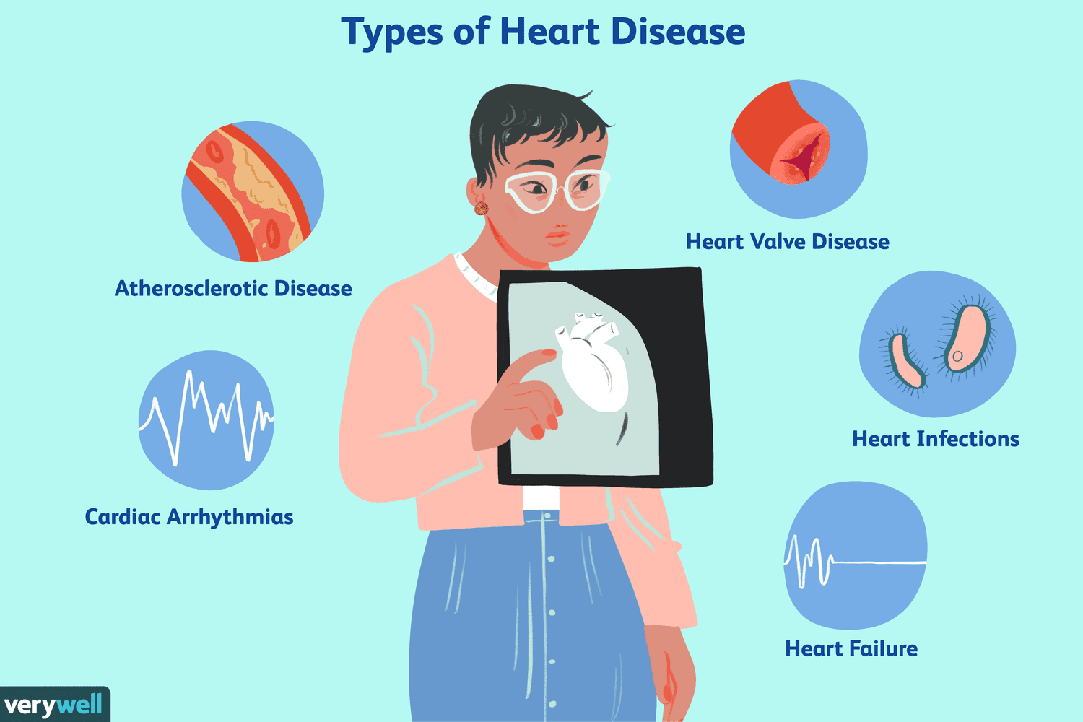
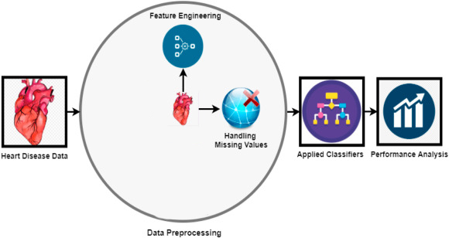
TYPES OF HEART DISEASES INCLUDE –
Heart Valve Disease
Heart Infections
Heart Failure
Cardiac Arrhythmias
Atherosclerotic Disease
Machine Learning can help identify these patterns by performing a series of steps -

Slide 4
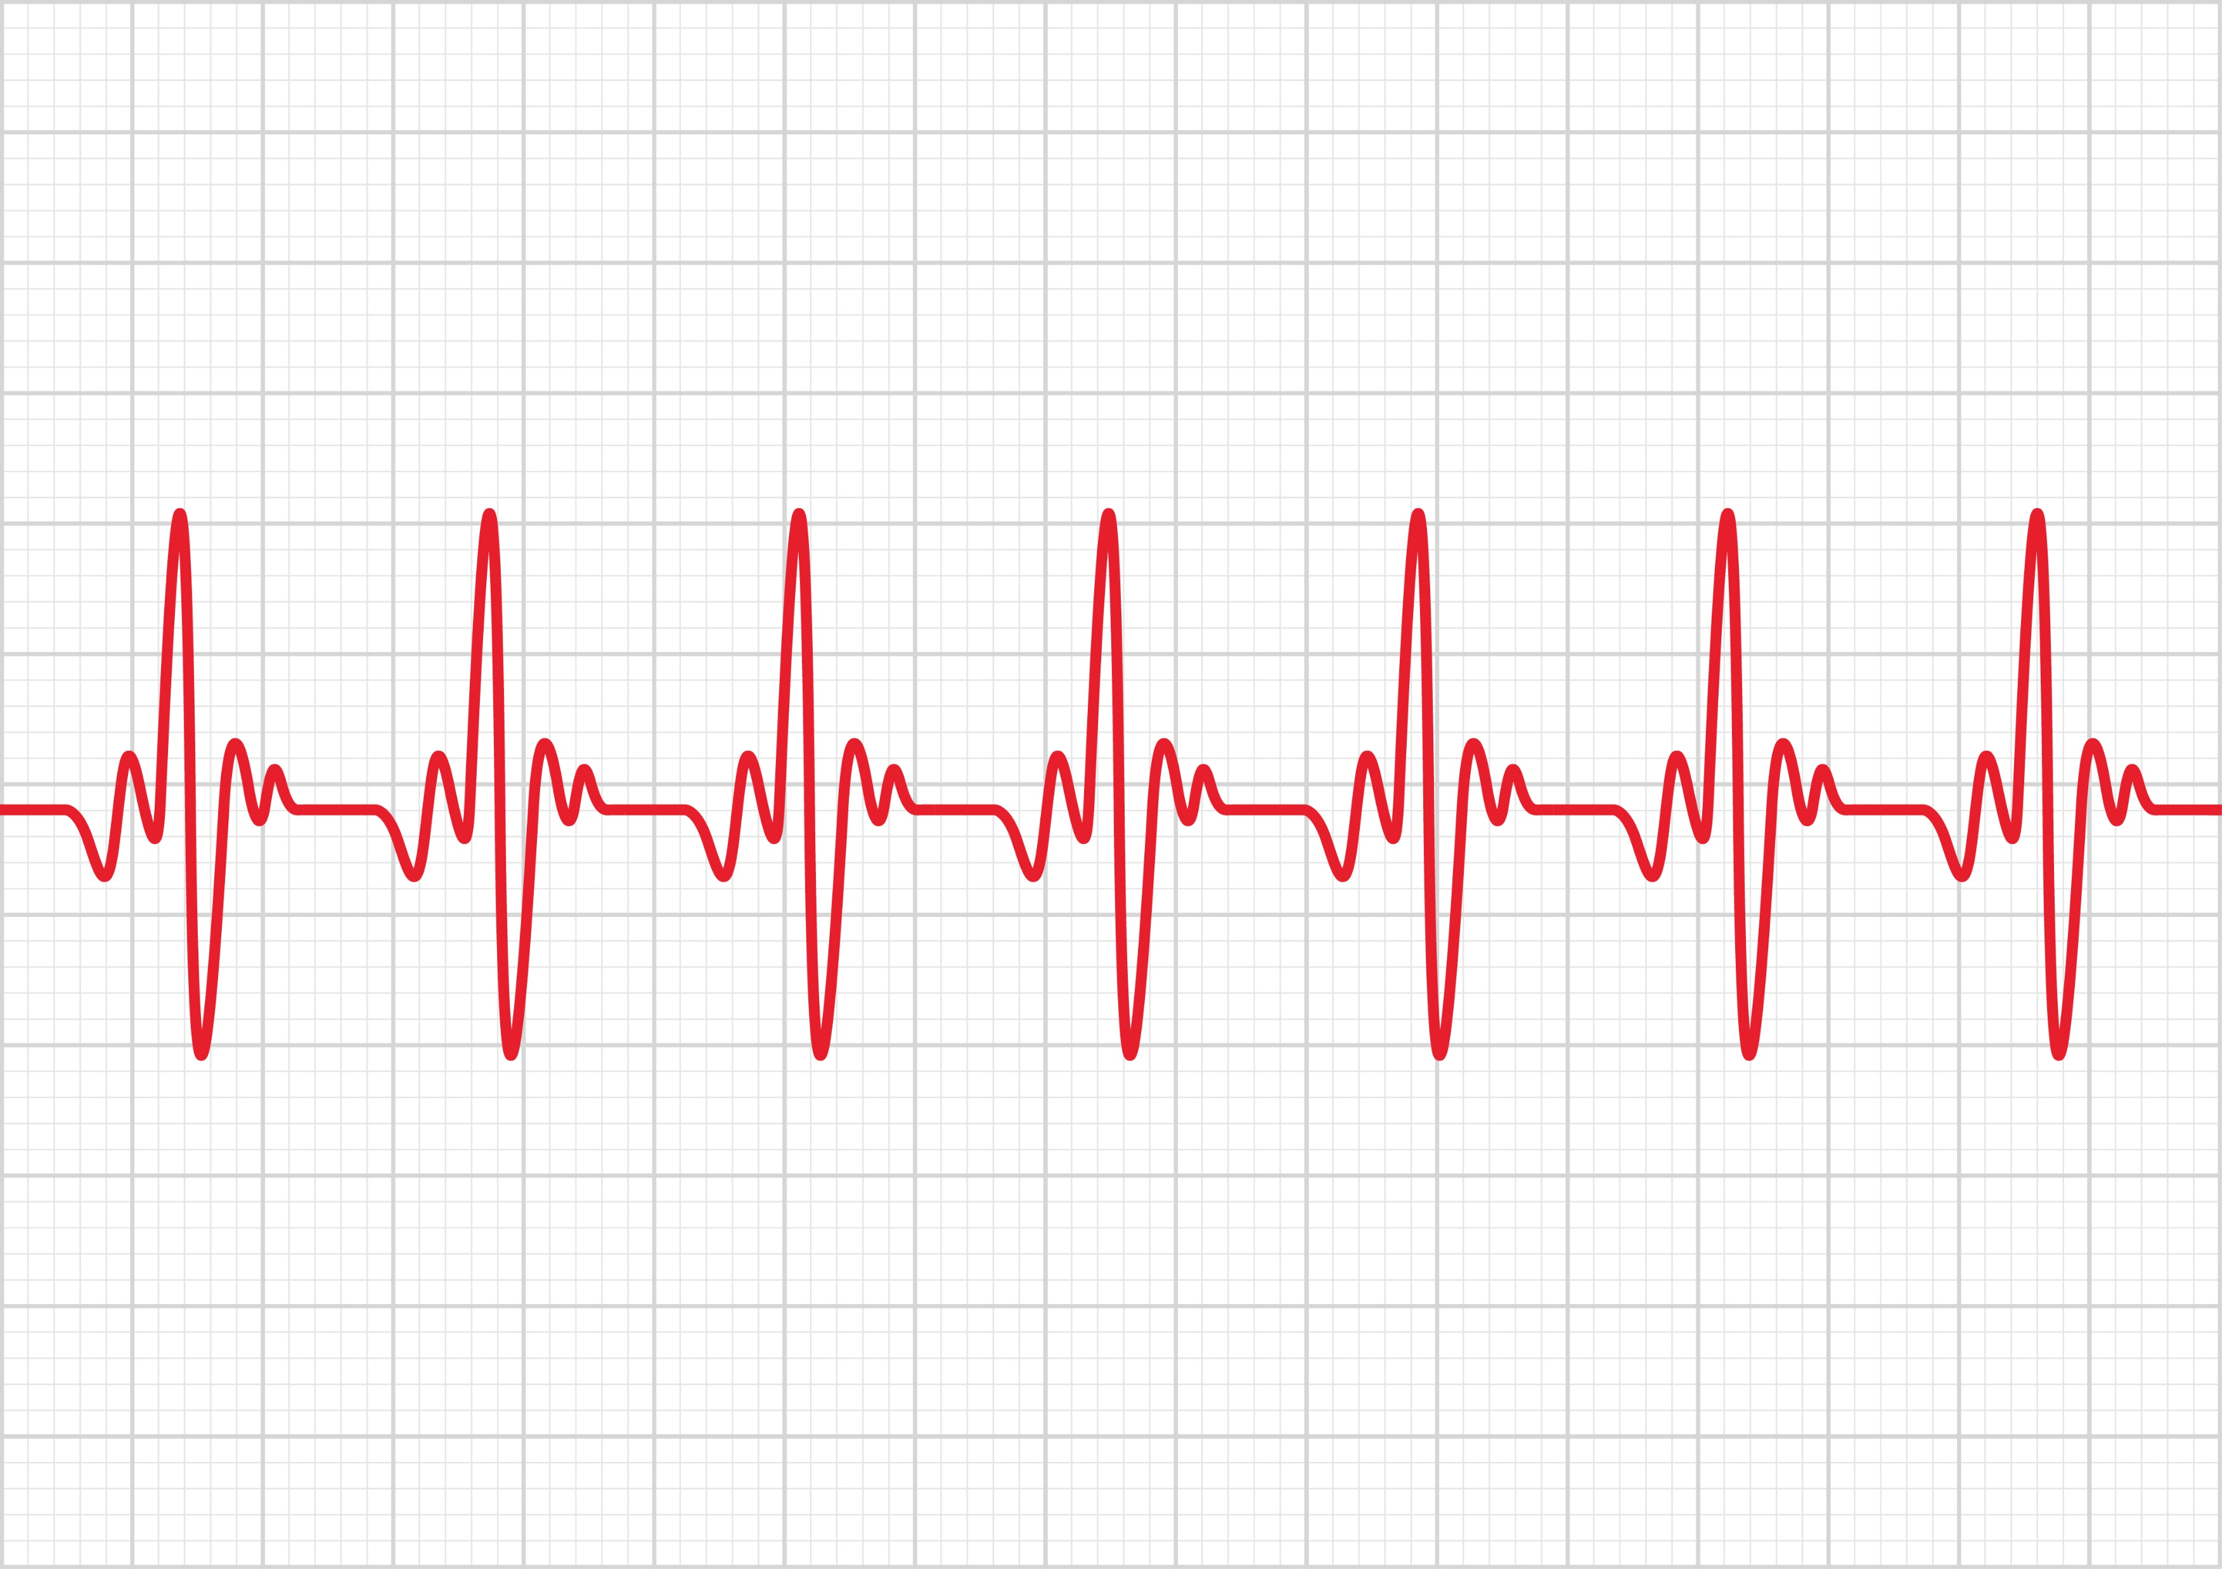
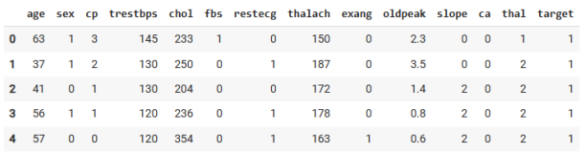
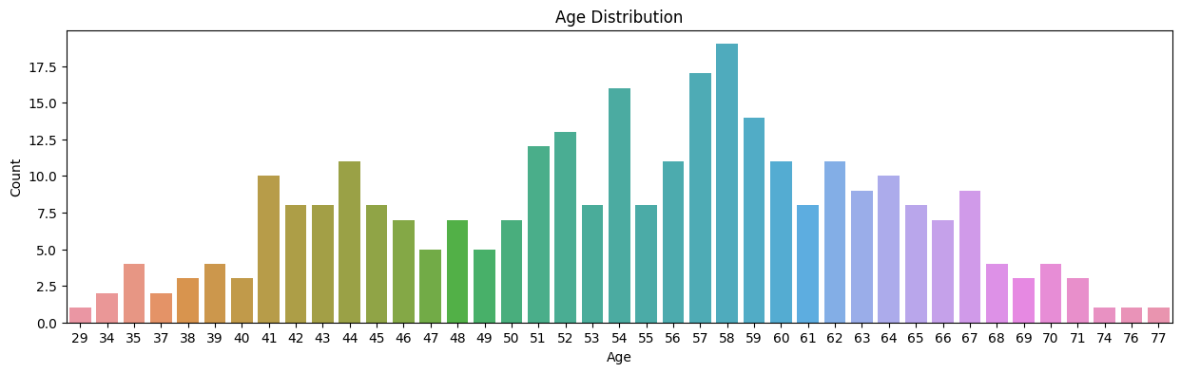
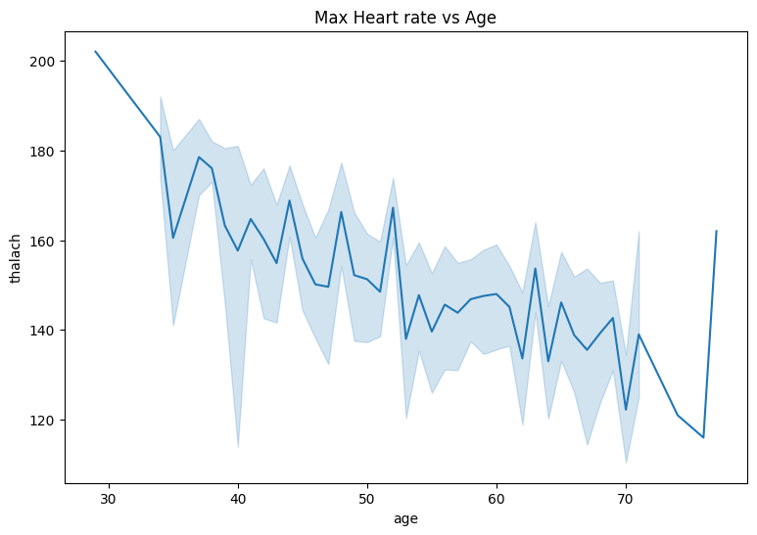
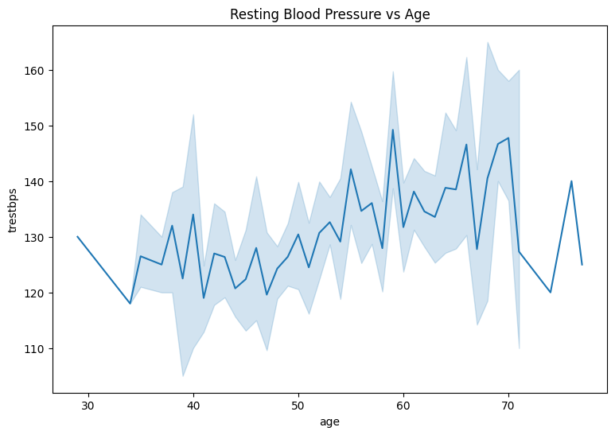
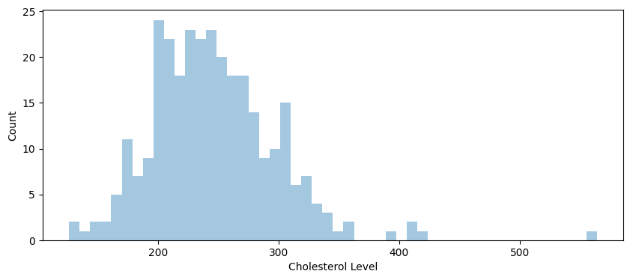
METHODOLOGY
The dataset used has the age, sex, chest pain type, Blood pressure at rest, cholesterol level, etc. of 303 patients.
Performing Exploratory Data Analysis on the dataset
Contd…

Slide 5
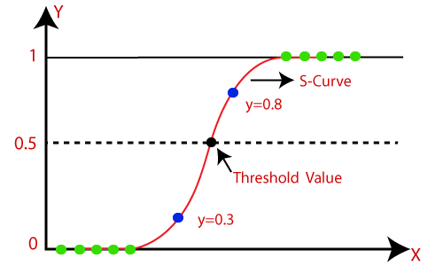
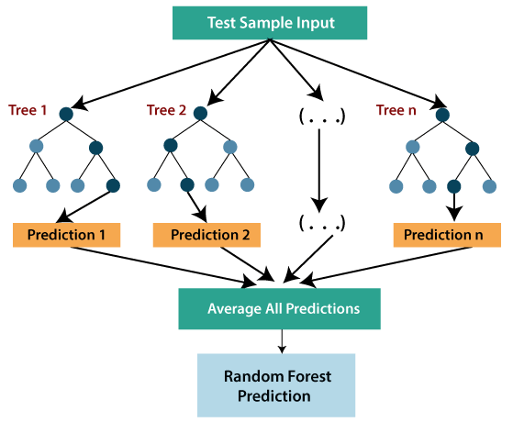
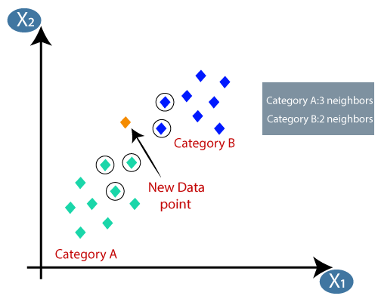
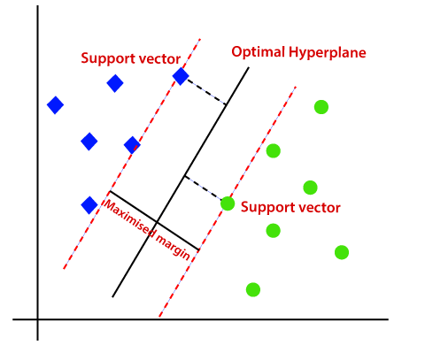
Model training: Various algorithms were used to train the model to test there efficacy.
Logistic Regression
Random Forest
K Nearest Neighbour
Support Vector Machines
Contd…

Slide 6
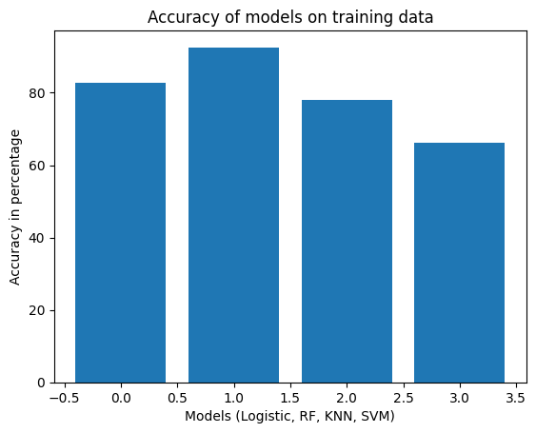
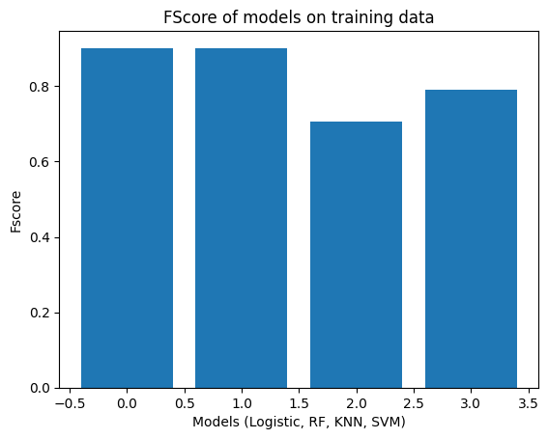
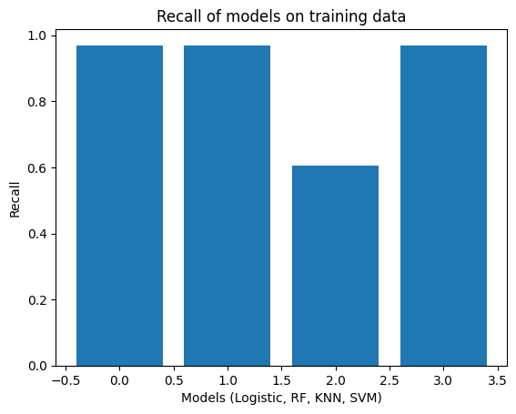
Model Evaluation on the basis of performance metrices
Logistic
RF
KNN
SVM
Logistic
RF
KNN
SVM
Logistic
RF
KNN
SVM
Based on Accuracy
Based on F Score
Based on Recall

Slide 7
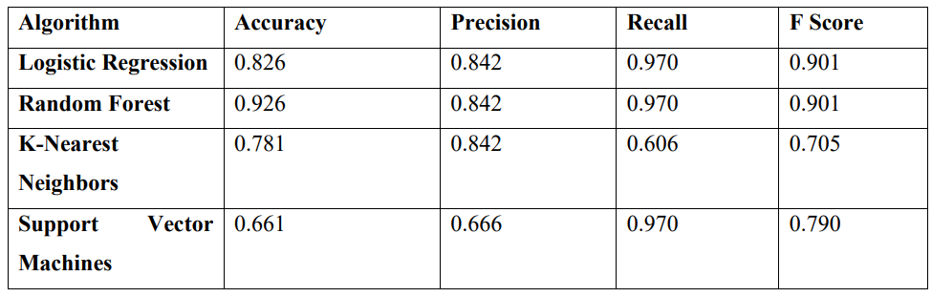
RESULT AND DISCUSSION
The dataset was divide into 20% testing and 80% training with random state=3
Comparative analysis of performance metrices of the deployed algorithms on training data.

Slide 8
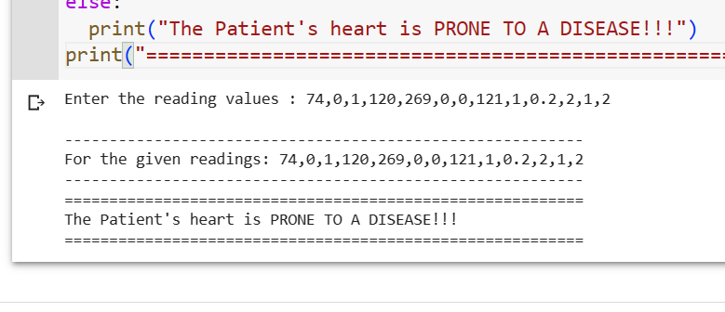
After the comparative study, Logistic Regression was chosen to train our model and values from the testing part of the dataset were entered.
We can see that our model predicted “Diseased heart” for the given set of readings and the dataset also has a value of ‘1’ on the result column for the above entries. (1 = Disease, 0 = Healthy)

Slide 9
CONCLUSION AND FUTURE WORK
Conclusion
In conclusion, we started by taking a dataset and performed EDA to understand the trends.
Then various machine learning algorithms were used to train the model and Logistic regression was used because it was the most suitable.
The model had an accuracy of 82.6% on the training set, which is realistic.
The model was tested on the testing set values and it performed as per expectations.
Future Work
A dataset of bigger size can be used to train the data and make more accurate predictions.
Use of CNN can be done to increase the efficacy on time series and Realtime data.
Increase the amount of entries in the dataset and thus reducing the chances of underfitting.

Slide 10
THANK YOU

